Slide 1

Copyright 2011
Texas State Florists' Association
PO Box 170760
Austin, Texas 78717
United States of America
All rights reserved, including the rights of reproduction and use in any form or by any means, including the making of copies by any photo process, or by any mechanical or electronic device, printed, written or oral, or recording for sound or visual reproduction or for use in any knowledge or retrieval system or device.
Texas State Florists’ Association
Power Point Presentation
for the
High School Floral Certification
Testing

Slide 2
Texas State Florists’ Association
Power Point Presentation
for the
High School Floral Certification
Testing
of the
Symmetrical Triangle Arrangement
and
Boutonniere
www.tsfa.org
512-834-0362
800-375-0361
txsfa@sbcglobal.net
Revised 2014

Slide 3
High School Certification
Testing Information
Must enroll by deadline date – usually in middle January
Check TSFA website www.tsfa.org for updated information
$100 Testing Fee,
if not receiving scholarship by application deadline
Must pass 100 question written exam: true/false, short answer, multiple choice, fill in the blank
Need #2 pencil
Must pass judging criteria for symmetrical design and boutonniere
Test Dates and Locations: to be announced each year
Check TSFA website www.tsfa.org

Slide 4
Additional Testing Information
Students will be provided with design bowl, 1/3 brick
wet floral foam, anchor tape, floral wire, floral tape,
and fresh product for hands on design
Students should bring knives, stem cutters/shears, and
wire cutters. There will be no tools provided
Written test and design portion will be timed
one hour for each section (written test and hands on)
Re-testing is available for students who do not pass
either test or do not pass one part (written or design)
Date, place, time: to be announced.
Check TSFA website: www.tsfa.org
$35.00 Re-testing fee

Slide 5
Symmetrical Triangle Arrangement
9 stems of carnations provided
10 stems of leather provided
7-10 florets of statice – approximately 3 stems provided
There will be no extra product provided
Students MUST be careful with product
Broken stems will not be replaced, may wire if needed
Will not count off for inferior product - judged on
stem placement only
Strict guidelines and procedures

Slide 6
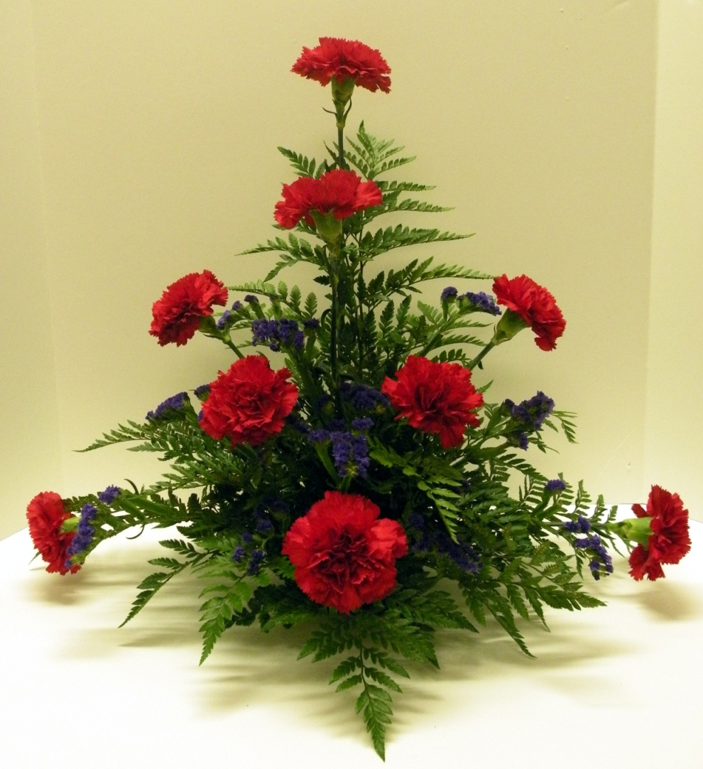
A Completed
Arrangement
Completed arrangement
with flowers, foliage and
filler

Slide 7
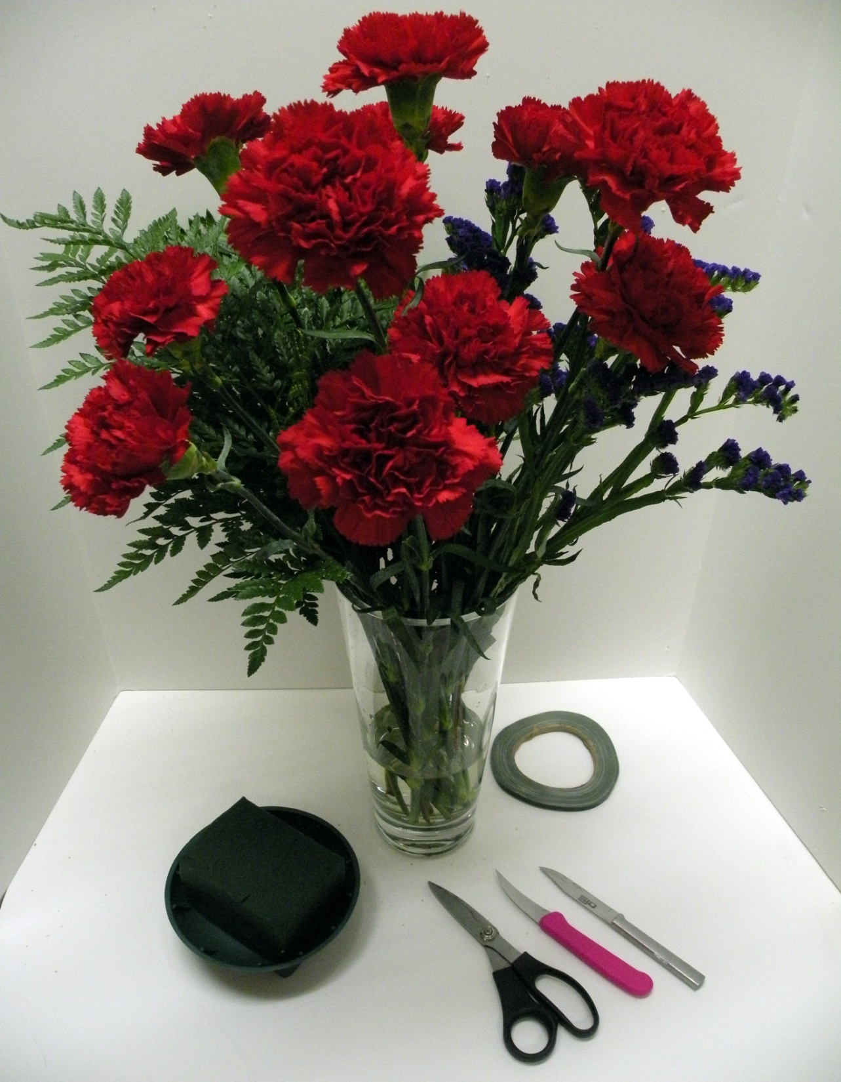
Required Materials
For Arrangement
9 Carnations
1/3 bunch Statice
10 stems Leather Leaf Fern
Container, Floral Foam
and Anchor Tape
#21 or #22 wire
Necessary Tools:
Wire Cutters, Clippers,
and Knife…Band Aids
(There will be no tools
provided)

Slide 8
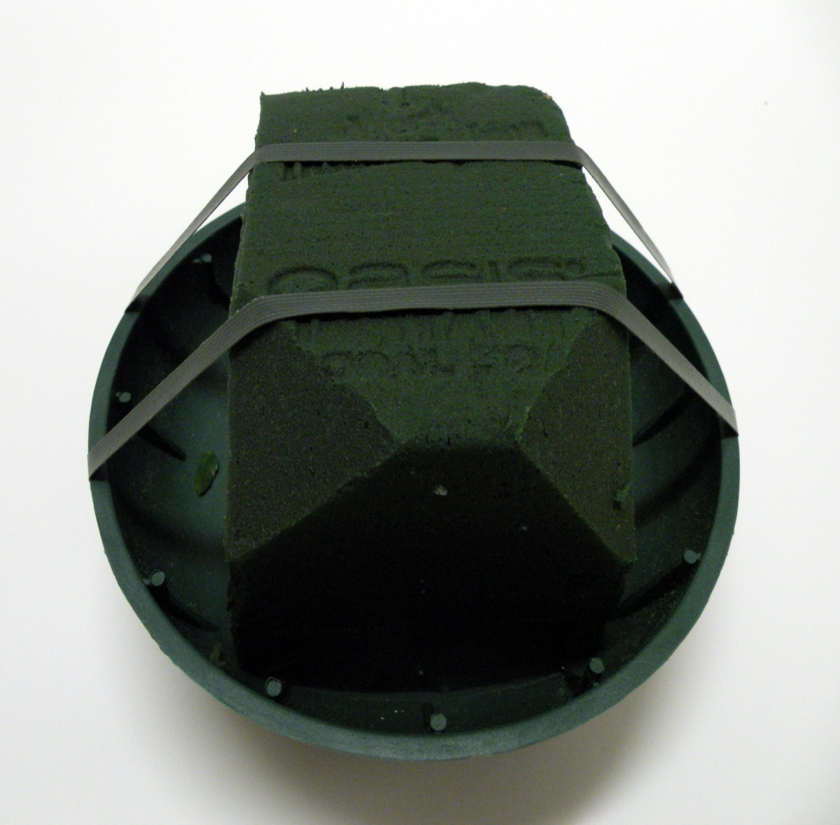
Prepare Container
for Design
1/3 block wet floral
foam
2 pieces ¼’’ anchor
tape enough to secure
oasis into bowl
Slice off front corners
of floral foam for
better insertion of
stems into front corner
area. (Suggestion only)
Front View

Slide 9
Insert Carnations
Cut stems at an angle
Stems must be secure in floral foam below water line
Should be no re-insertions
Must develop symmetrical triangle
Carefully measure before cutting stems
Develop skeleton of design in steps 1-9
May fluff tight or non round carnations before
inserting into floral foam
Filler flowers to be inserted between carnations,
placing them high and low to create depth

Slide 10
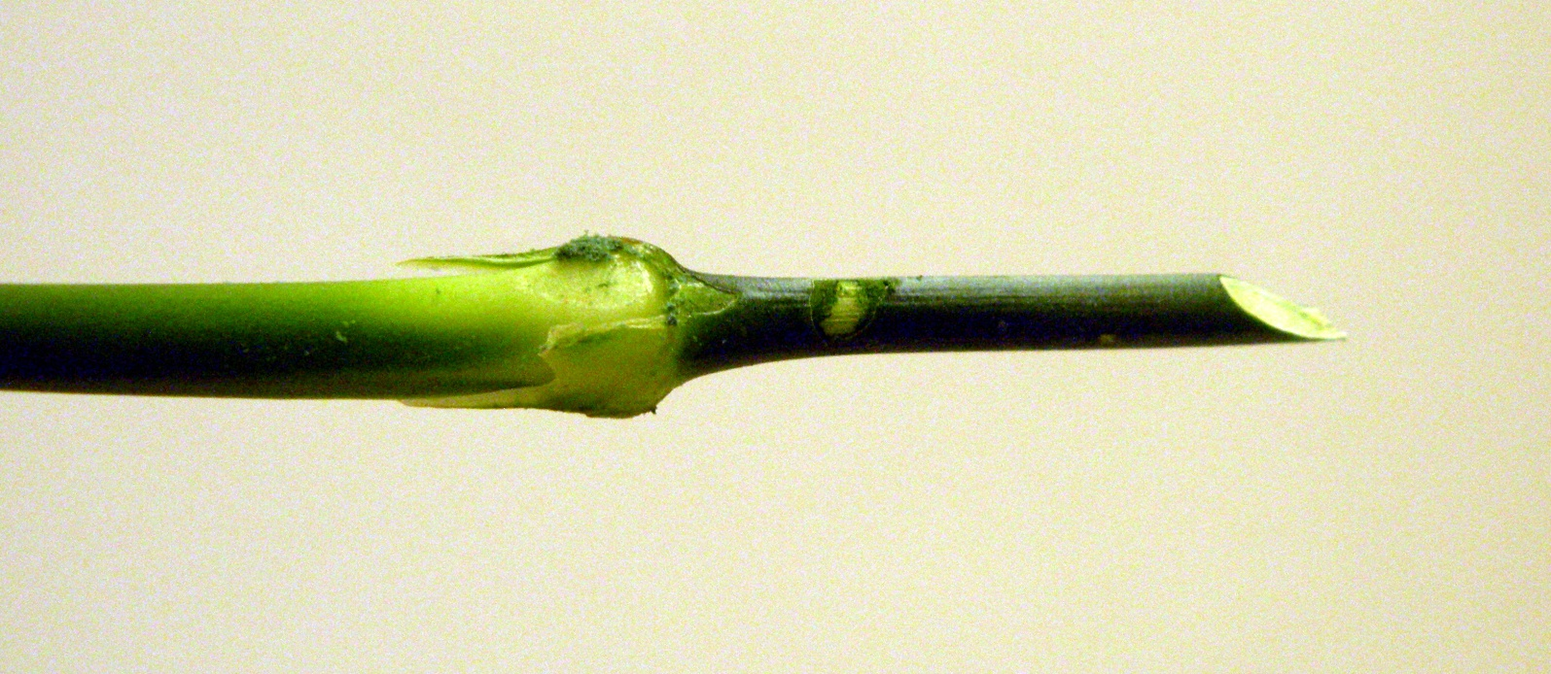
Cutting Stems For Insertion
Stems should be cut with a knife
at an approximate 45 degree angle,
immediately prior to stem insertion into the floral foam

Slide 11
9 Stem Insertions
Into The
Floral Foam
Placement of stems
to form the
Symmetrical
Triangle Skeleton
Front View
Floral Foam with Insertions

Slide 12
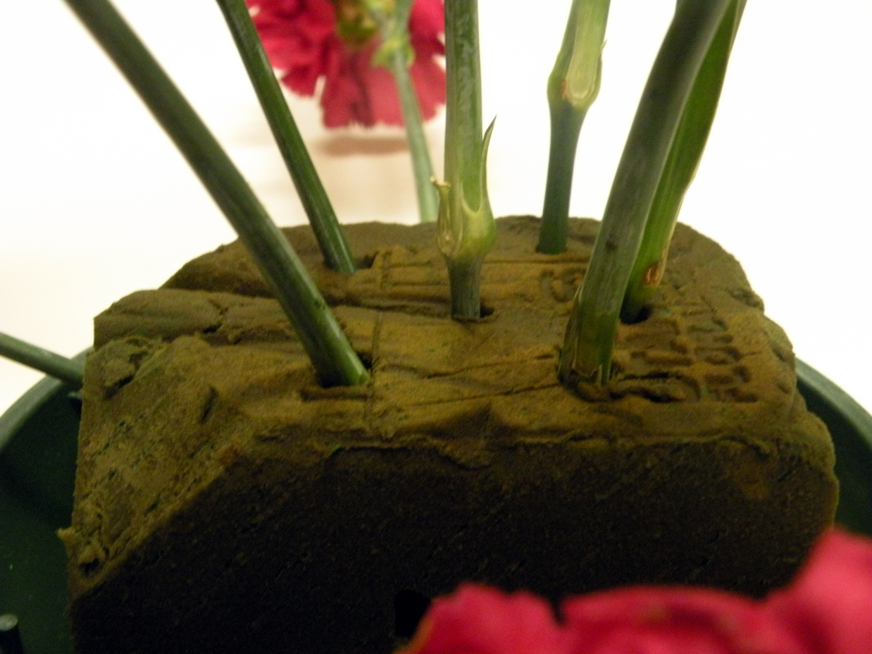
9 Stem
Insertions
(Side View)
Placement of stems
into lengthwise floral
foam creating a
Symmetrical
Triangle Skeleton
2
4
7
1
6
5
9
8
3
Side View
Lengthwise Floral Foam
with Insertions

Slide 13
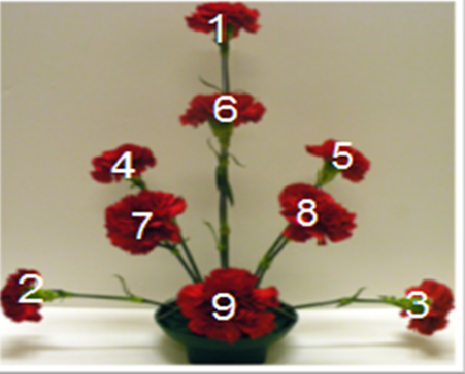
Overview: Placement of
skeletal stems
for Symmetrical
Triangle
Arrangement
Front View

Slide 14
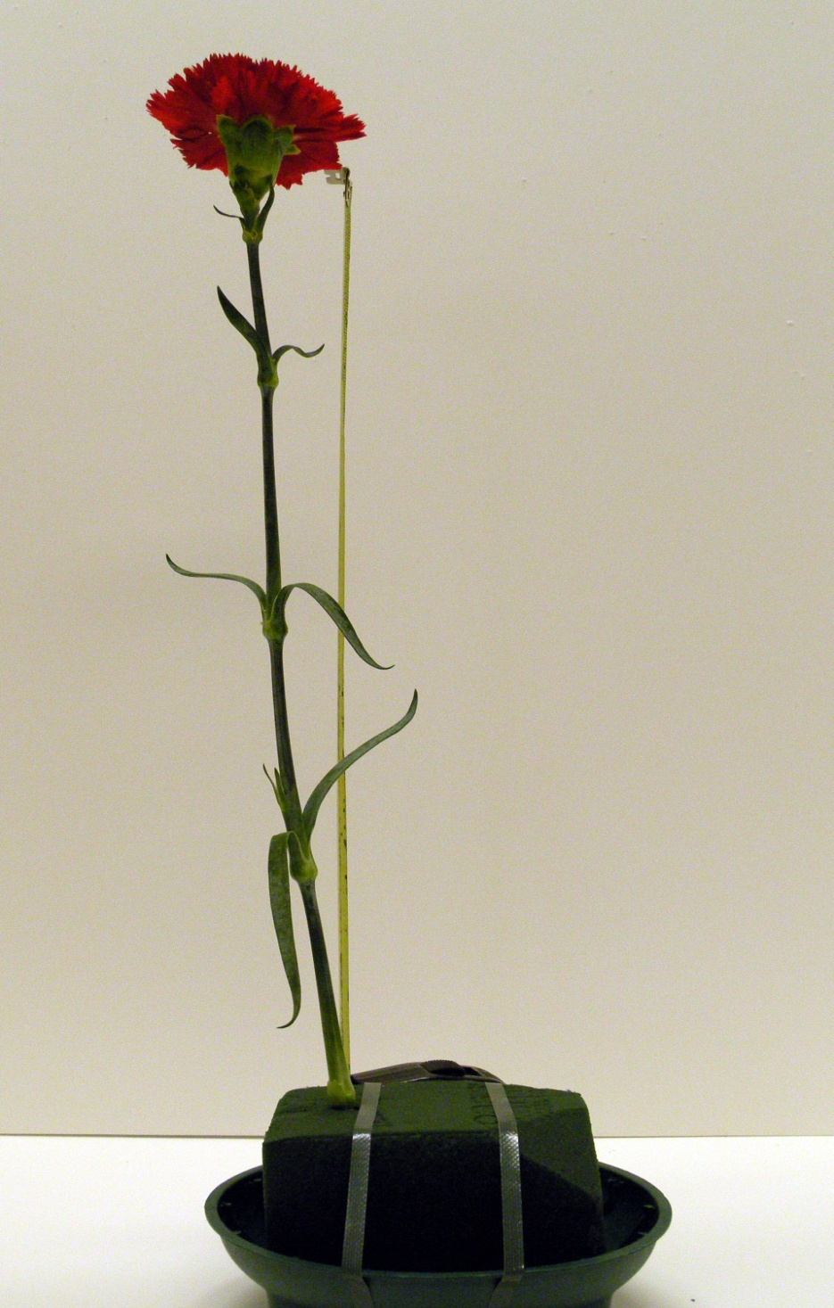
___
Beginning Insertions
The first stem (#1) will be
approximately 18” tall and
will be inserted toward the
back of the foam, using the
lengthwise direction of the
of the foam
Insert the stem approximately
2” into the foam as upright as
possible with no more than
a 95 degree angle
Note: 90 degree angle
to use as a guide
(The stem should lay no
further back than shown
in example)
11
90 degree angle
16”
___
2”
___
Side View

Slide 15
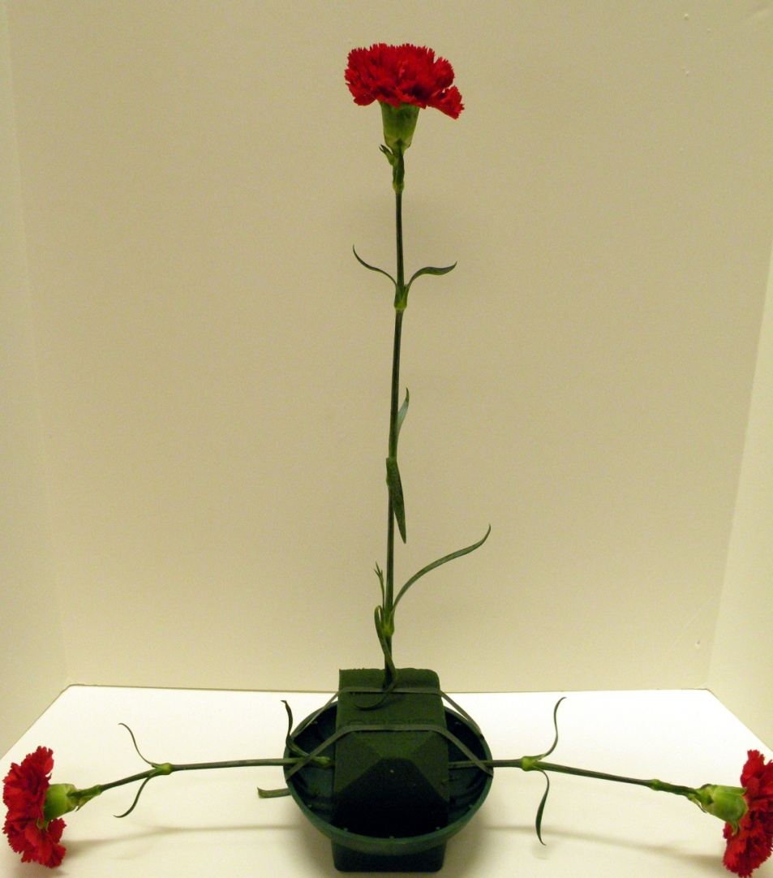
Insertion of the
#2 and #3 Stems
The combination width
of the two stems will be
approximately 18 inches.
Insert the stems half
way between the length
of the oasis in front of
the vertical stem.
You are creating depth
and space within the
arrangement by
placement of these
insertions.
18”
1
18”
2
3
Total width is approximately 18”

Slide 16
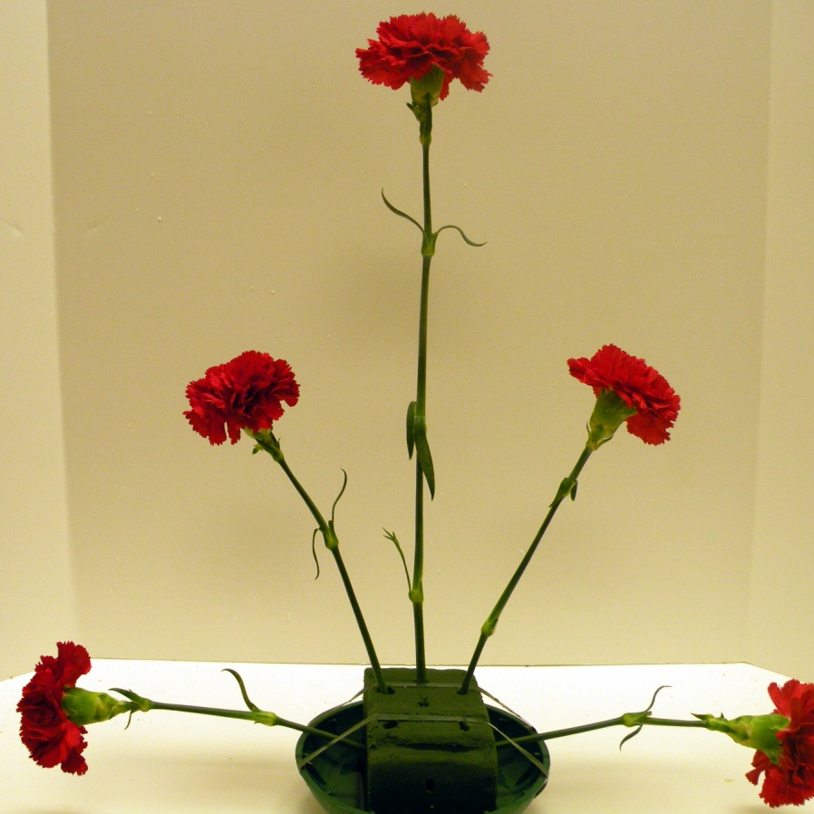
Insertions of
#4 and #5 Stems
Insert #4 and #5 in front of the
line of #1 stem and behind
the line of the #2 & #3 stems.
The stems will be inserted
toward the focal point/area and
will lean slightly back.
The stems will also be
inserted closer toward the`
center of the floral foam.
4
5
Front View

Slide 17
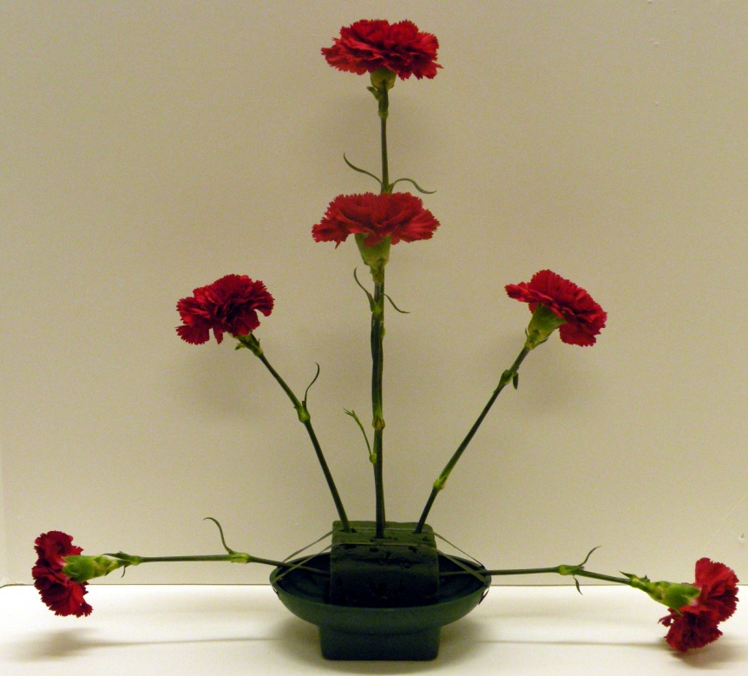
Insertion of
#6 Stem
The second vertical
stem, #6, is placed
directly in front of
the #1 stem
6
Front View

Slide 18
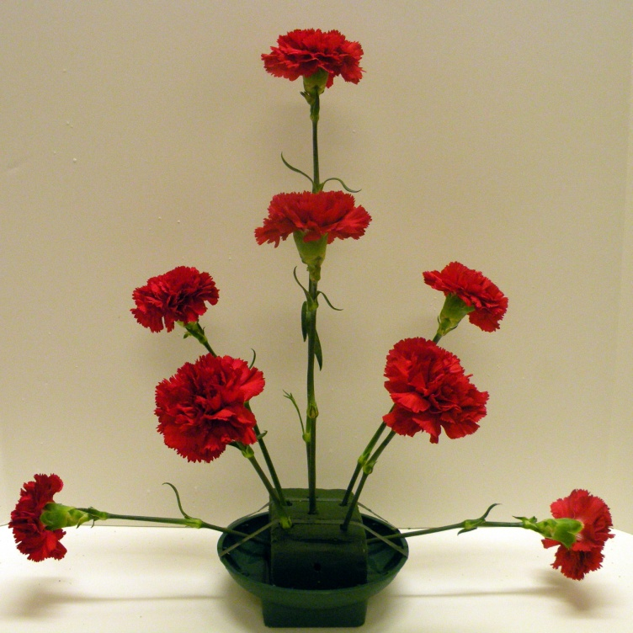
Insertions of the
#7 & #8 Stems
The #7 and #8 stems are
placed in front and toward
the center of #4 an #5 stems.
The stems are inserted in
a direct line toward the
focal point/area creating a
V shape from #4 and #5
insertions
7
8
Front View

Slide 19
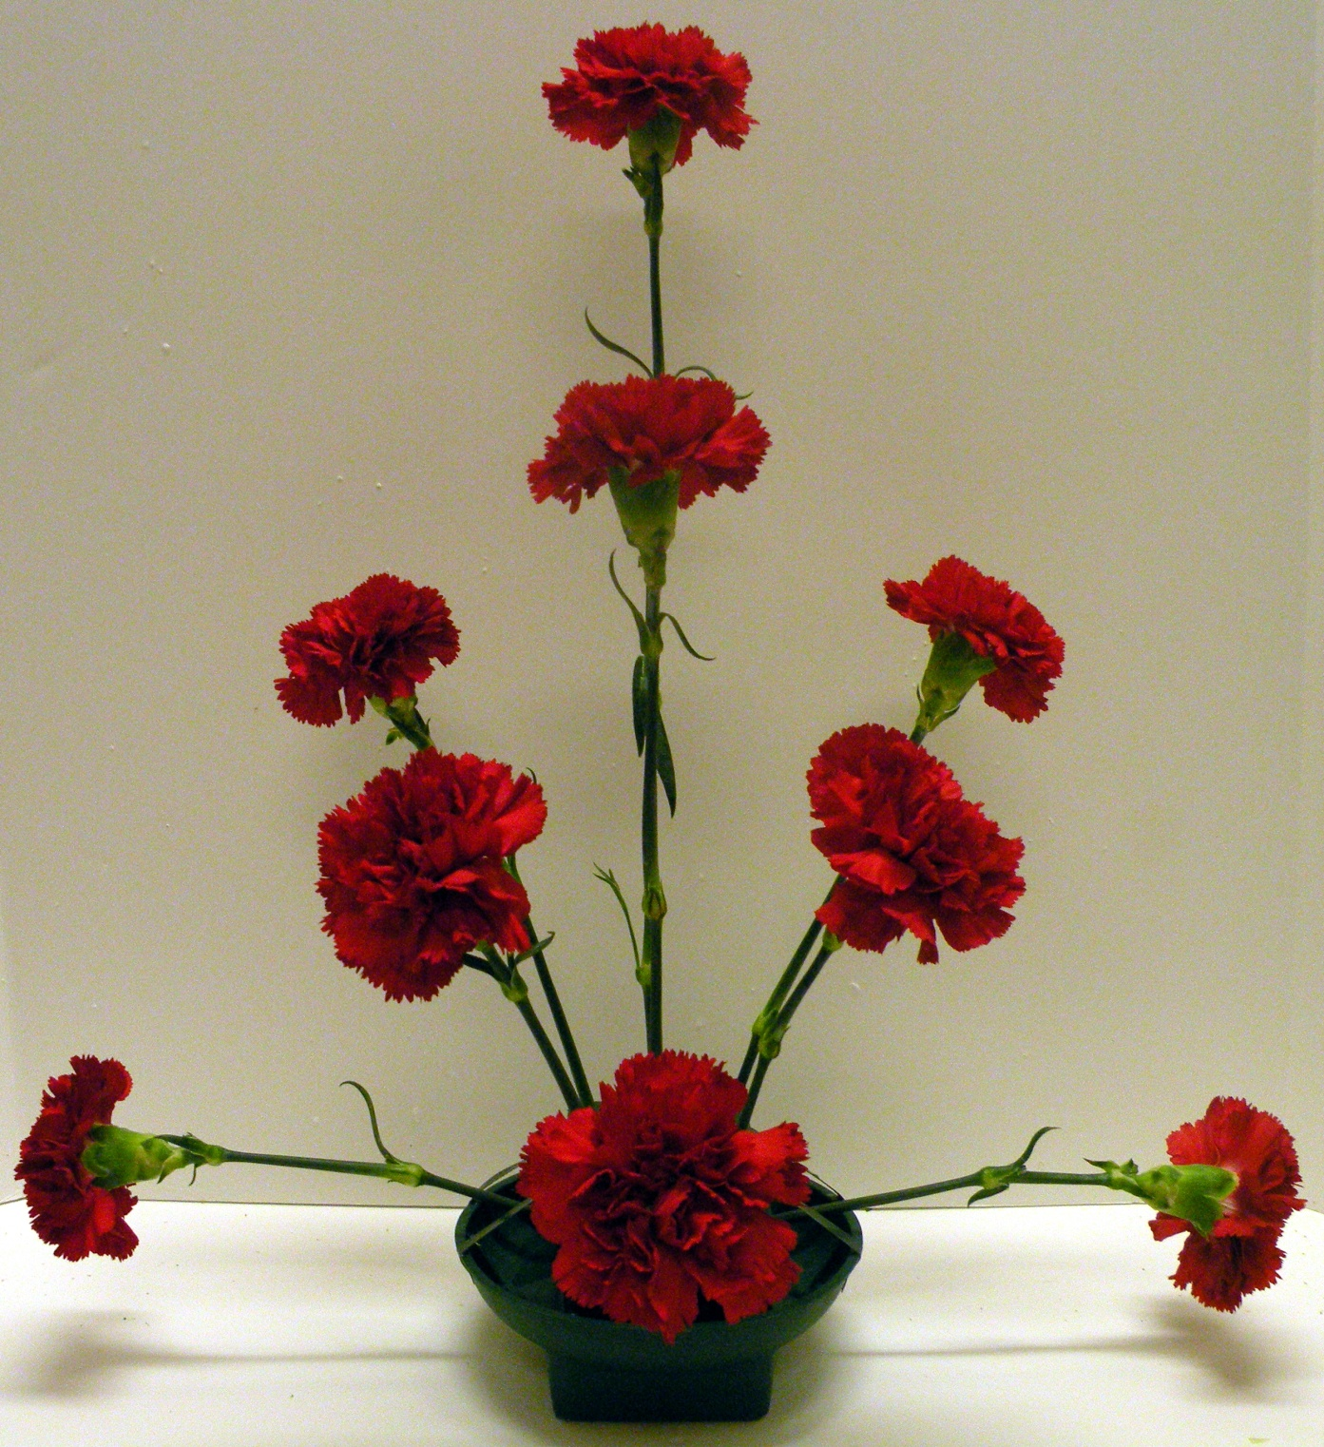
Insertion of #9 Stem
This stem is placed
in front of #1 and #6
stems near (but not
directly on) the lip of
the container.
This insertion
defines the focal
point/area of the
arrangement. All
stems (flowers,
foliage and filler)
will radiate from
this point.
Stems become
shorter and tighter,
as they near the
focal point/area
9
Front View of Skeletal Symmetrical Triangle Arrangement

Slide 20
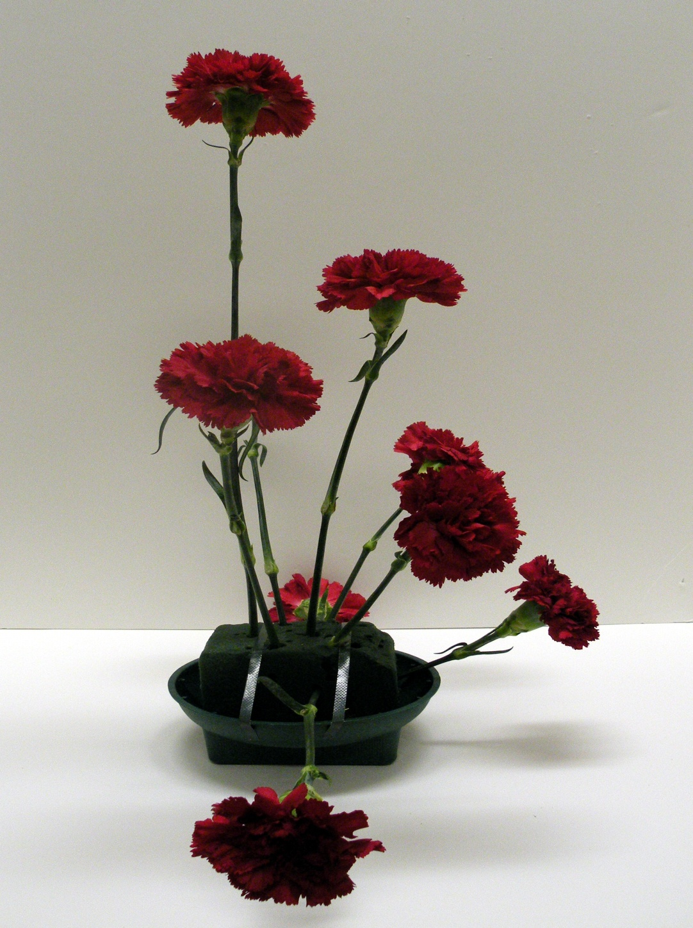
Side View of
Skeletal Symmetrical
Triangle Arrangement
Side View

Slide 21
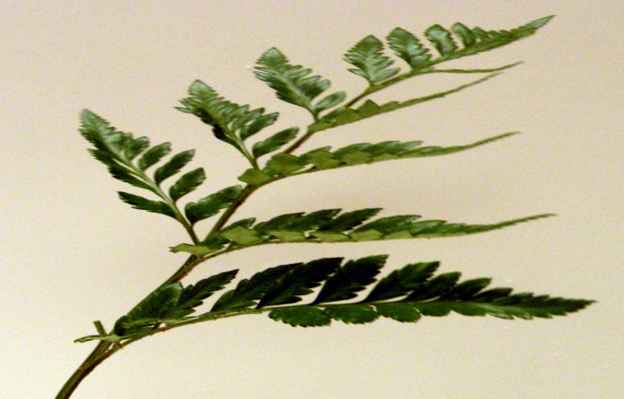
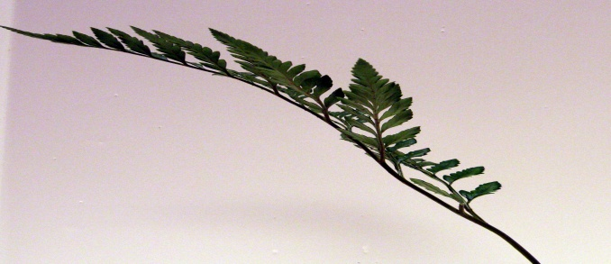
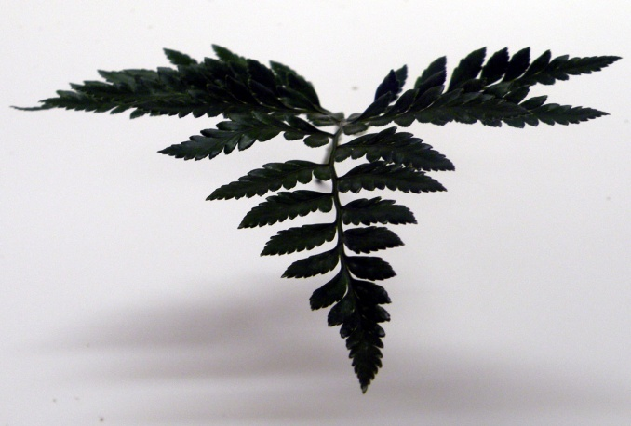
Inserting Foliage
You may add filler or foliage
as the next step
If adding foliage first:
Begin adding Leather Leaf in the
same manner you inserted your
flowers
Foliage should cover the stems
and floral foam
When you trim the length of a
stem, save the excess to be
used to fill in, where needed
A stem must be inserted at least
1” - 2” deep into the oasis,
in order to take up water
Enter from right side toward focal point
Enter from left side toward focal point
Enter from front center toward focal point

Slide 22
Insert Leather Leaf Fern
Follow same insertion pattern as carnations
Leather should support carnation stems
Insert leather closely behind carnations
Keep greenery wings for filler pieces, i.e.
front spaces and to fill gaps and cover foam
No anchor tape should be visible
No floral foam should be showing
Do not cut foliage into tiny pieces and insert
into floral foam

Slide 23
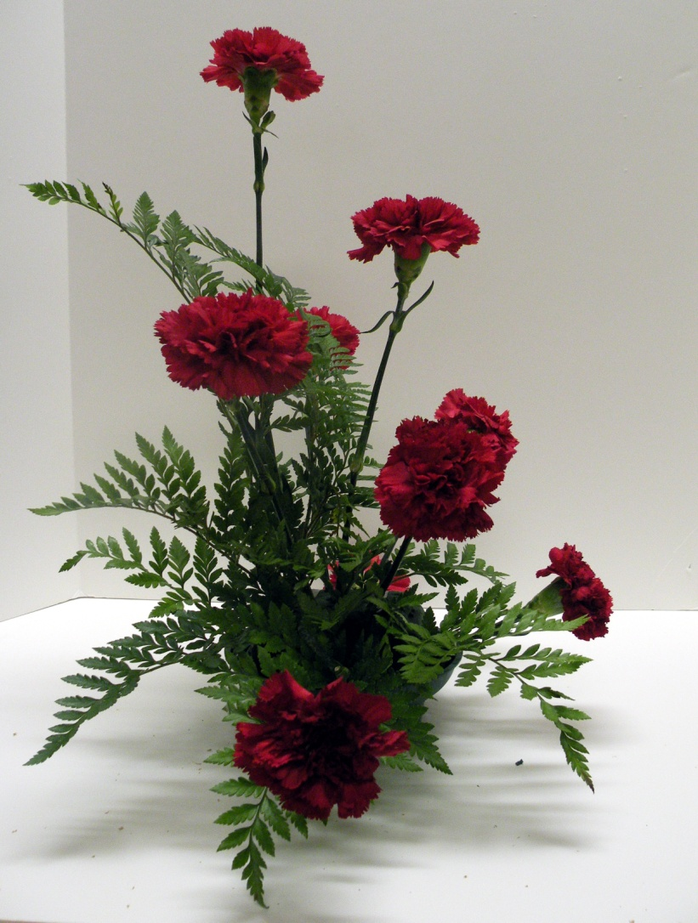
Inserting Foliage
Photo shows side view
of the symmetrical triangle
and the foliage which
shadows the carnation
stems
Side View with First
Insertions of Foliage

Slide 24
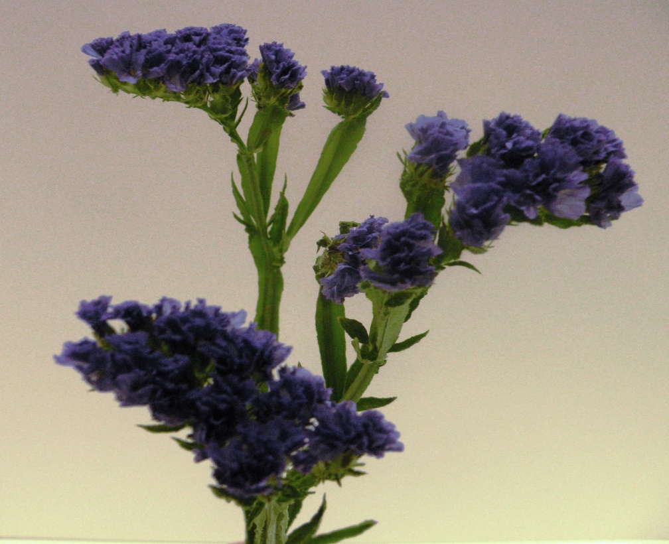
Filler
Statice is a filler flower
with multiple breaks
on each stem.
Each bloom/floret on
the stem, may face a
different direction.
When designing with
statice, you will need
to separate the breaks
so that you are using
the blooms/florets in
the correct direction.
They must follow the
lines within the
arrangement.
Purple Statice

Slide 25
Insert Filler
Should be placed deeper than carnations to fill in
empty spaces
If using directional fillers, they should radiate
out of design
Insert filler securely into floral foam
Do not over fill design with filler; graders will
count off for this; must consider price points of
design, do not have to use all filler material
provided

Slide 26
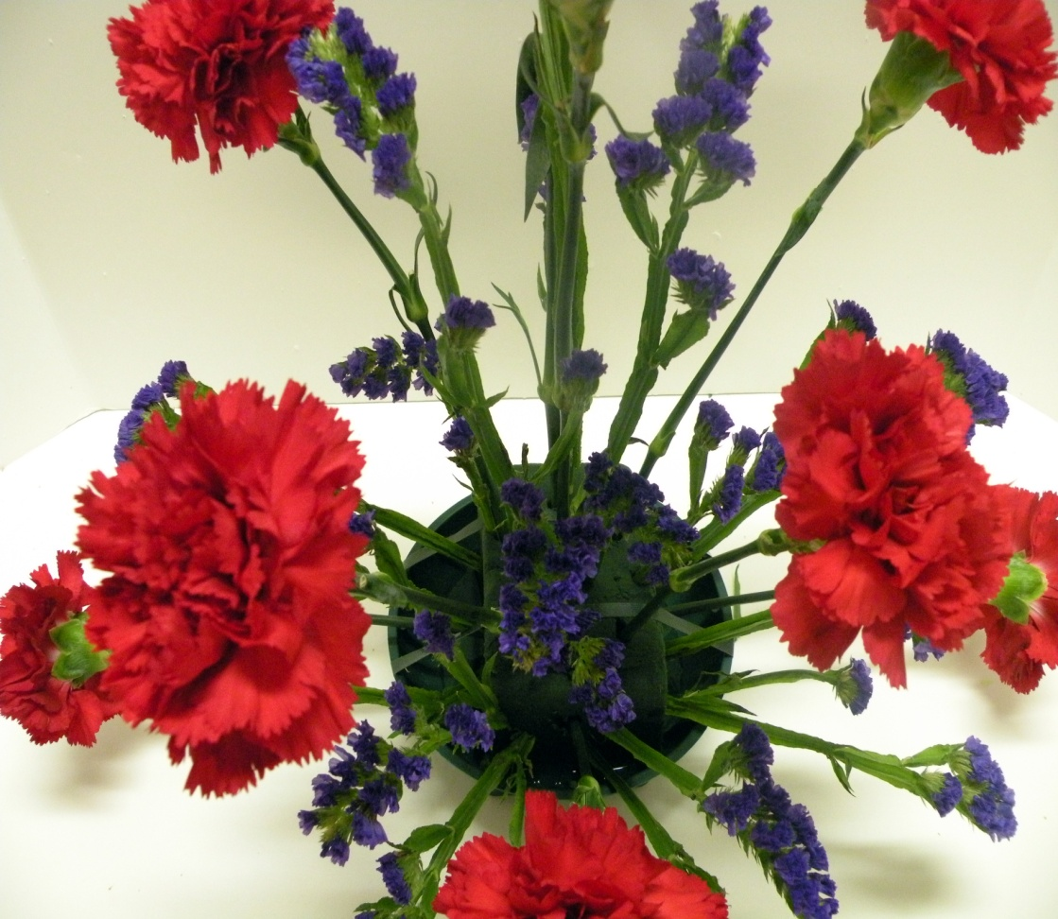
Directional Placement
of Filler
Statice blooms/florets
will radiate from the
focal area with the
tip of the bloom
pointing outward.
Each stem may have
multiple directions of
florets on a stem. You
separate and use so
that each radiates
correctly.
* Filler should be placed in
after the foliage

Slide 27
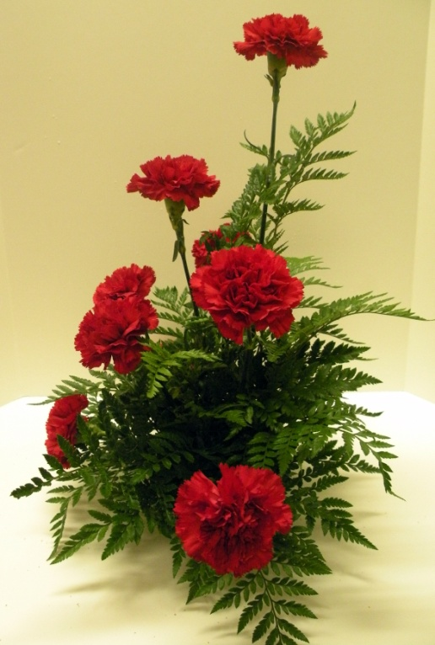
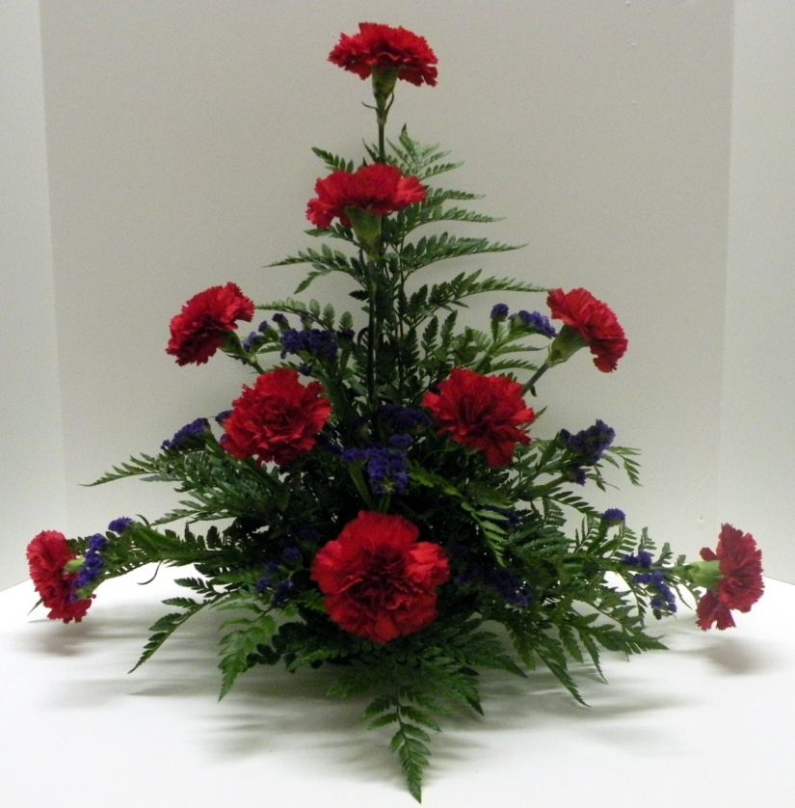
Side and Front Views of Symmetrical Triangle Arrangement
Side View
Back View
Front View

Slide 28
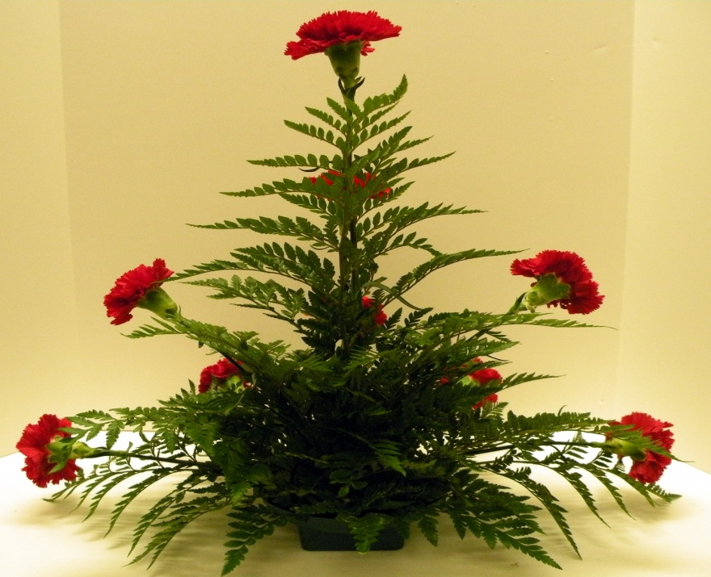
Back View of
Symmetrical Triangle
Arrangement
Back View of Completed
Arrangement

Slide 29
The Completed
Arrangement
Completed arrangement
with flowers, foliage and
filler
The photo shows depth
created by the filler
and the emphasis of the
focal point created by
bringing some of the filler
and foliage in tighter/
shorter toward the #9
carnation

Slide 30
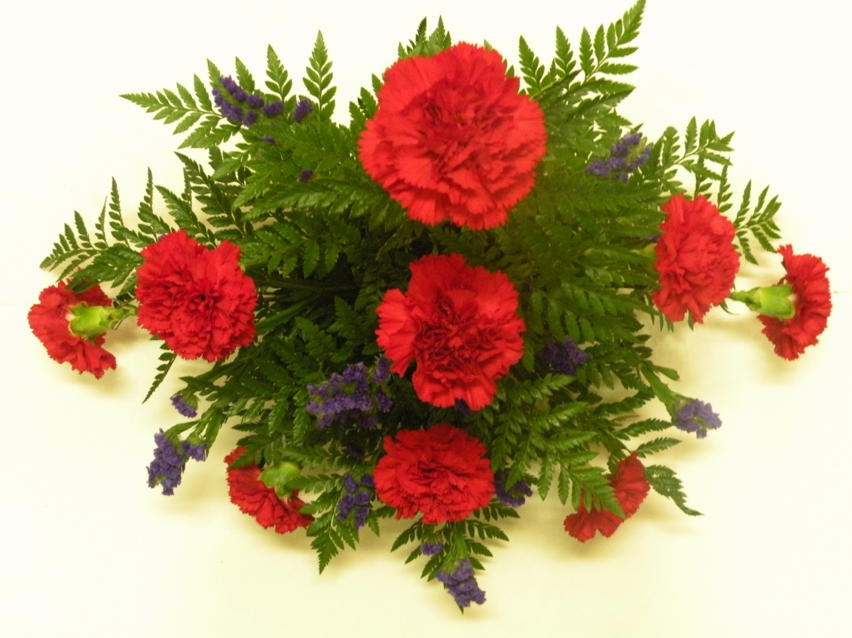
Top View
Of
Finished
Arrangement

Slide 31
Design Conclusions
Design will be judged on stem placement, NOT
product quality
Smaller blooms placed on outside edges of design
and larger blooms to inside/interior of arrangement
for depth and focal
DO NOT make design short and dense. Cannot
determine space and proportion within arrangement
Arrangement should be approximately 18” tall and
approximately 18” wide. With this height and width,
space will be created within the arrangement.
Mass flowers (carnations) MUST NOT touch each
other.
Graders will not count off for broken carnation stems
that have been re-wired together and taped correctly.
Repair broken stems/carnations as needed

Slide 32
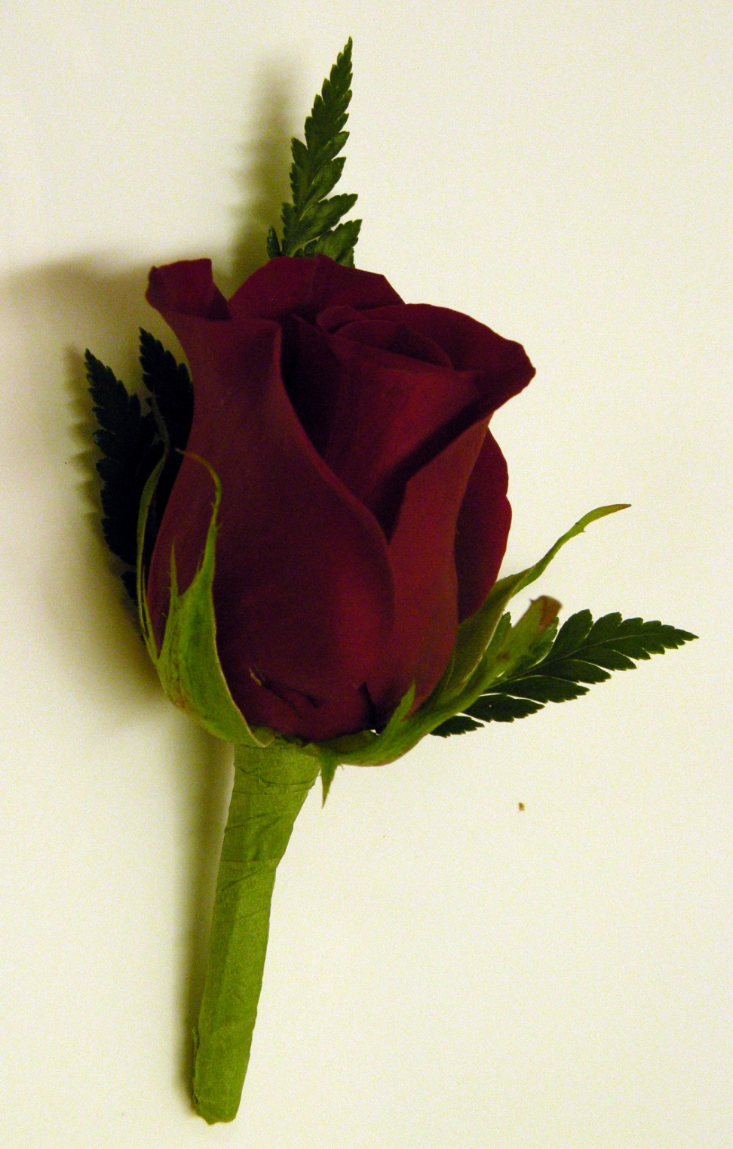
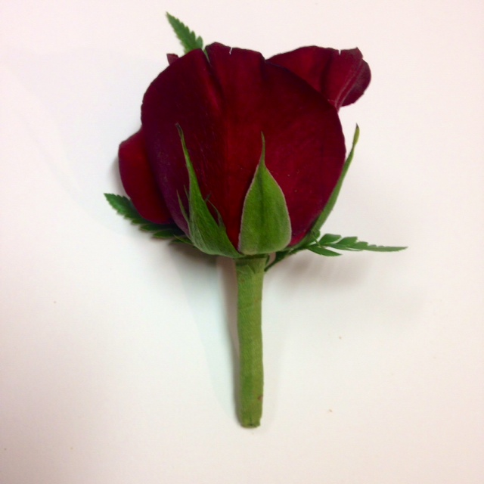
Rose
Boutonniere

Slide 33
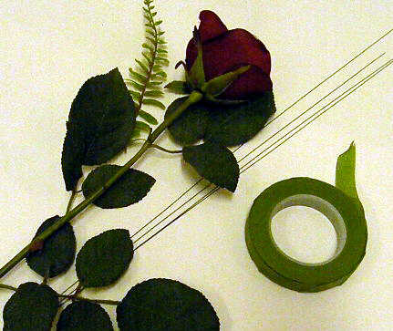
Required Materials
For Boutonniere
Small Rose head (50 cm)
appropriate for boutonniere
(ie Charlotte Red Rose)
Foliage – Small piece
of Leather Leaf Fern
#28 wire or #26 wire
Floral Tape

Slide 34
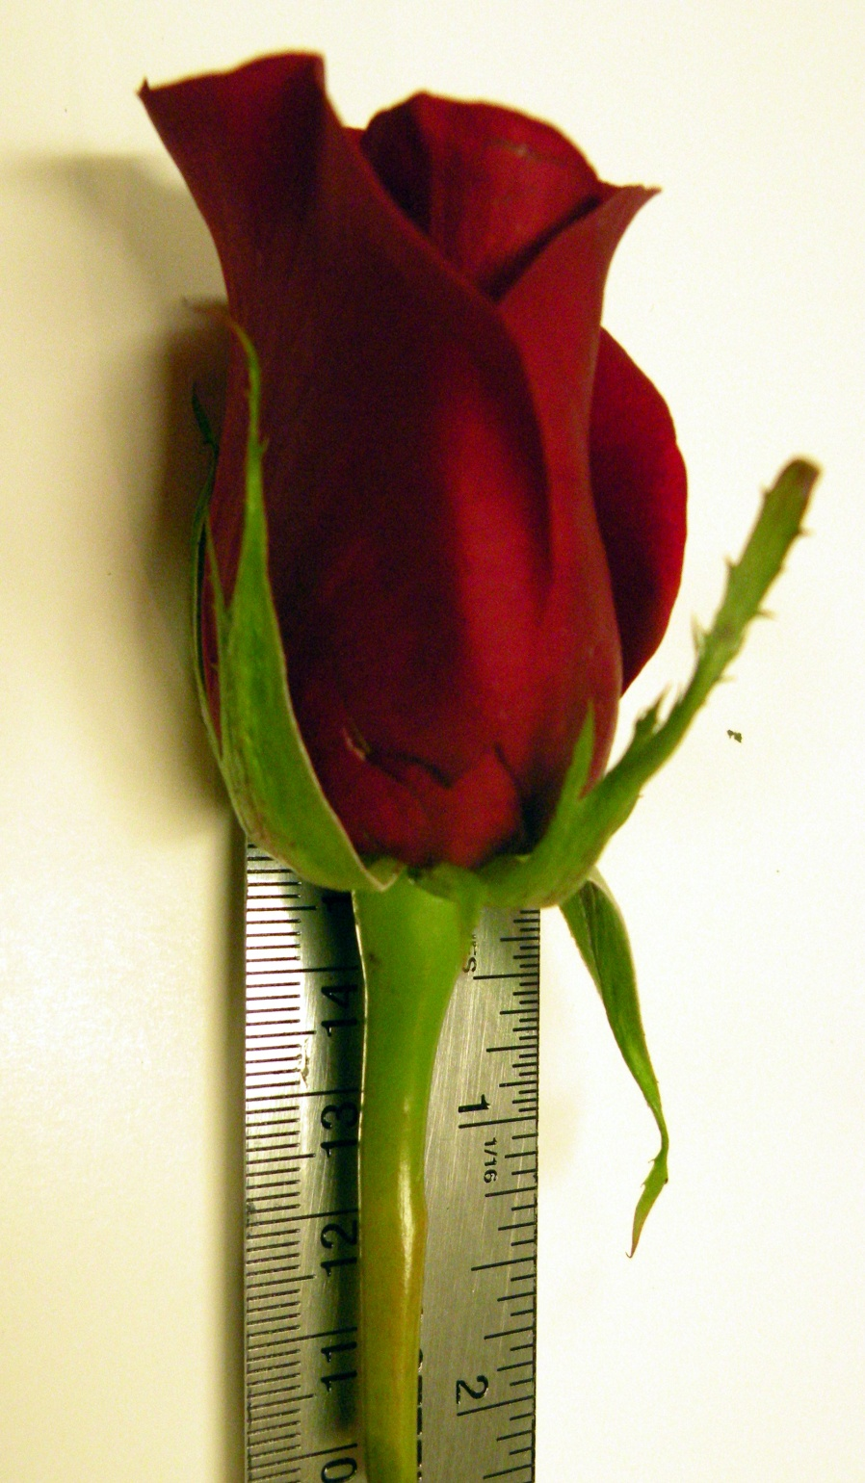
Boutonniere Stem
Length
Stem length for a rose
boutonniere should be
proportionate to the head size
approximately 1 1/2” to 2 ½”

Slide 35
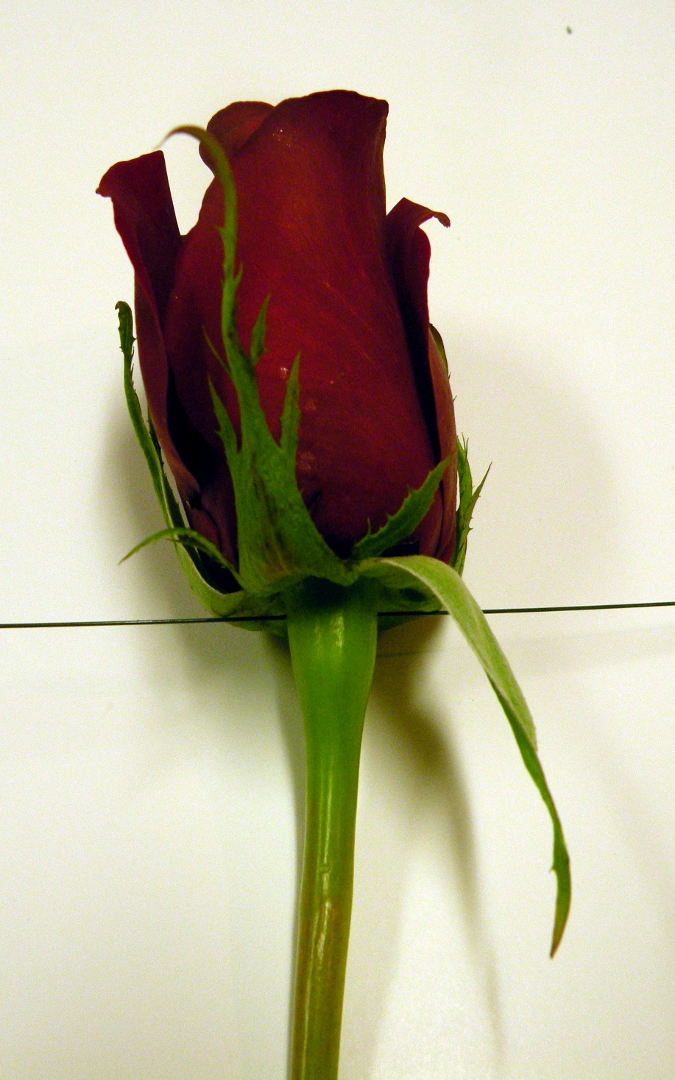
Inserting Wire
Use ½ length of a
#28 or #26 wire, pierce
through the
receptacle of the rose
receptacle

Slide 36
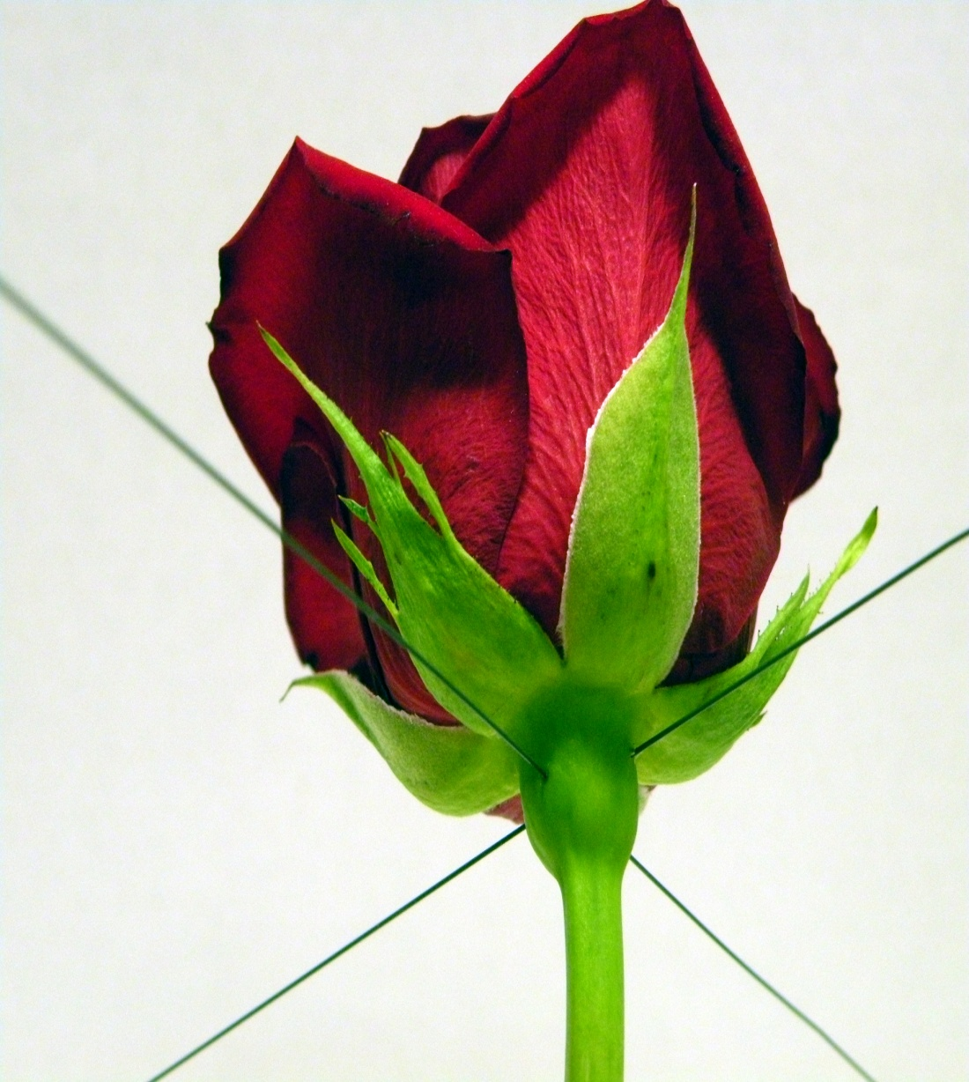
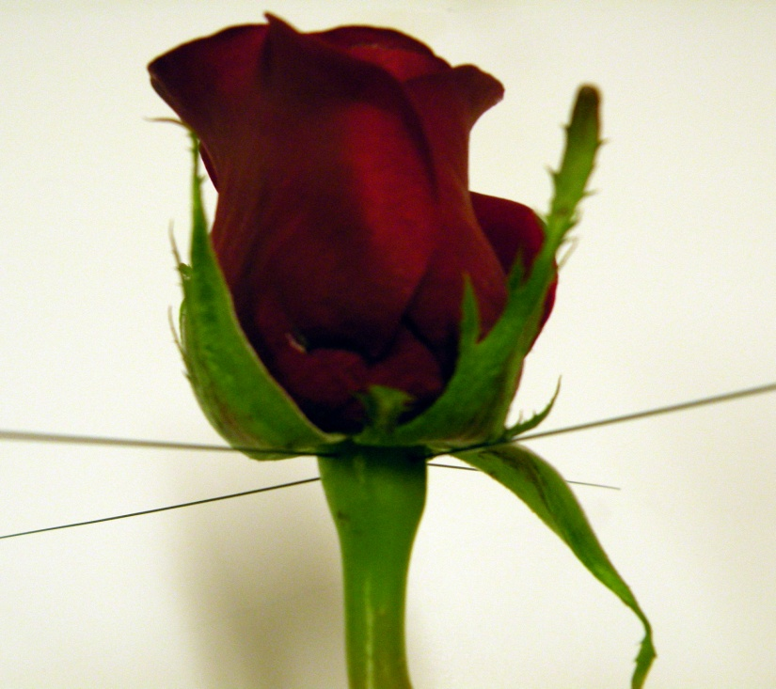
Inserting Second Wire
Using a second
#28 or #26 wire, cross
pierce the receptacle
slightly lower than the
first insertion
Note: using a #26 wire will make the boutonniere heavier and the
stem less easy to pierce with a
boutonniere pin
See example pictures
for cross insertions

Slide 37
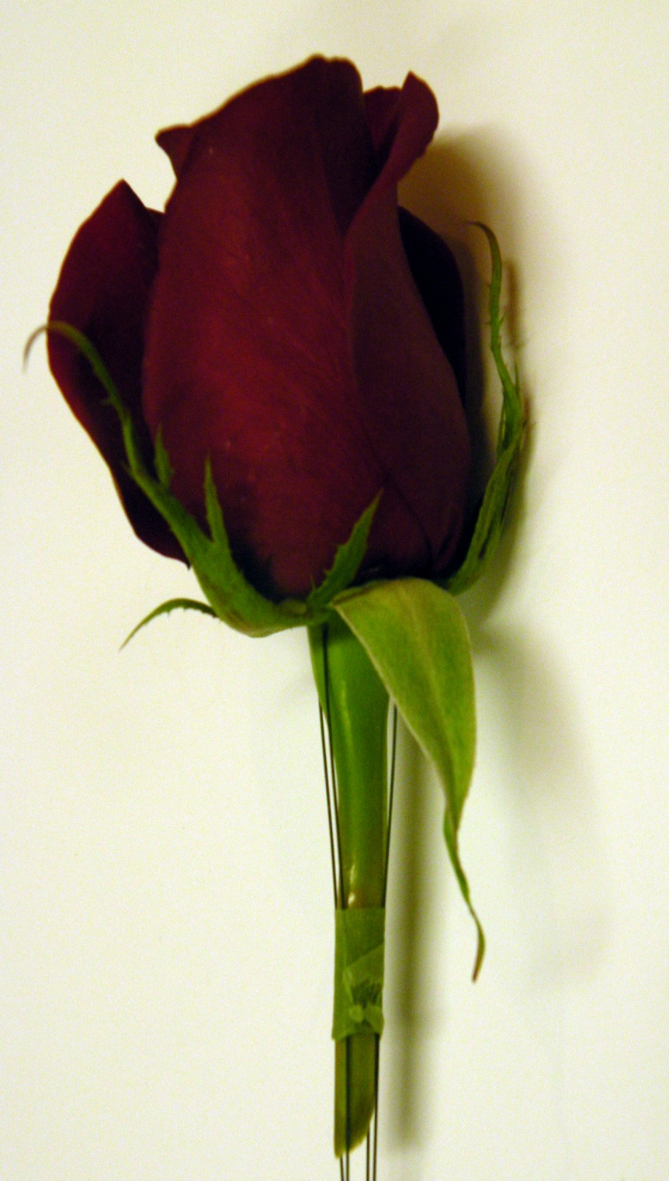
Securing Wires
In order to keep the wire
parallel to the stem and
prevent spiraling around
the stem of the rose, you may
want to floral tape around
the lower portion of the stem
to hold the wire straight and
parallel to the stem, before
completing the taping of the
entire stem.
Note: (If you have a torn or
broken sepal, rotate it to the
back side of the rose head.
DO NOT REMOVE. If more
than one sepal is bad, you
may trim or re-shape, but do
not trim all sepals).
sepal

Slide 38
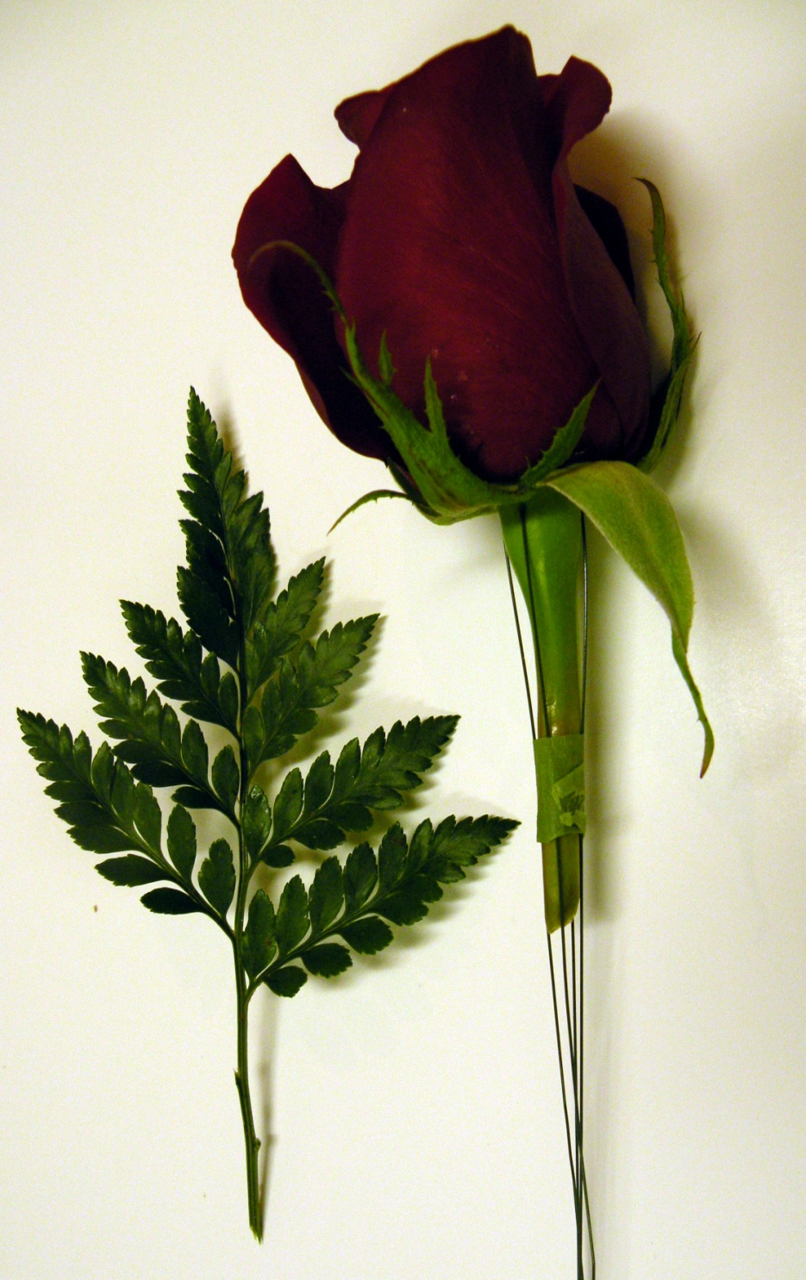
Foliage
Choose a tip from the
Leather Leaf Fern that is
proportionate to the size of
the rose head. Foliage is
an accent only and should
not over power the design.

Slide 39
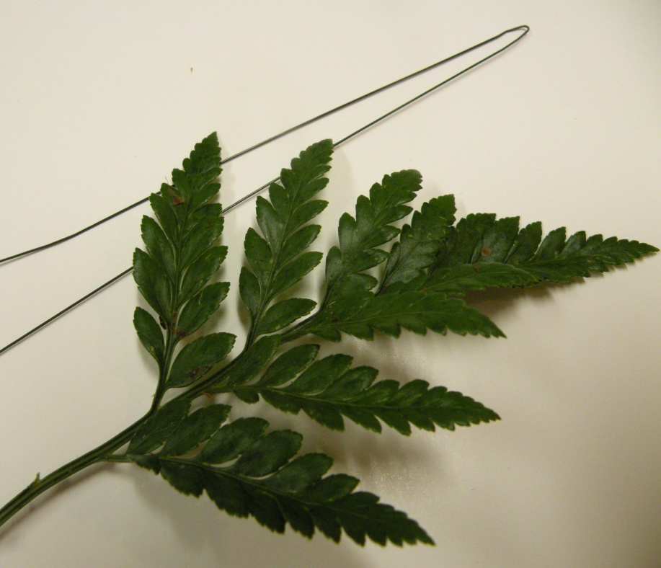
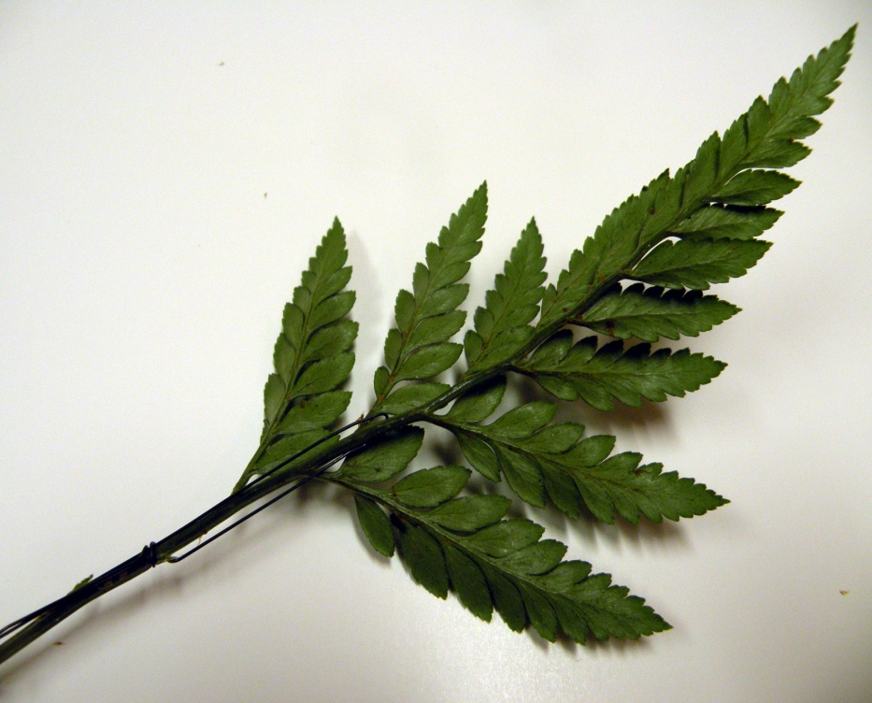
OPTIONAL:
WIRING LEATHER LEAF FERN
It is not necessary to wire your
foliage
However, If you choose to wire
the Leather Leaf Fern,
create a hairpin of ½ length #28 or #26
wire
Thread through the two lower fronds and
pull the wire straight down parallel
to the stem.
Tape partially down the rose stem
to prevent the leather leaf stem
from spiraling around the stem
and then tape over the entire rose stem.
* Leather Leaf is very delicate and easy
to break, again, wiring is only a choice!

Slide 40
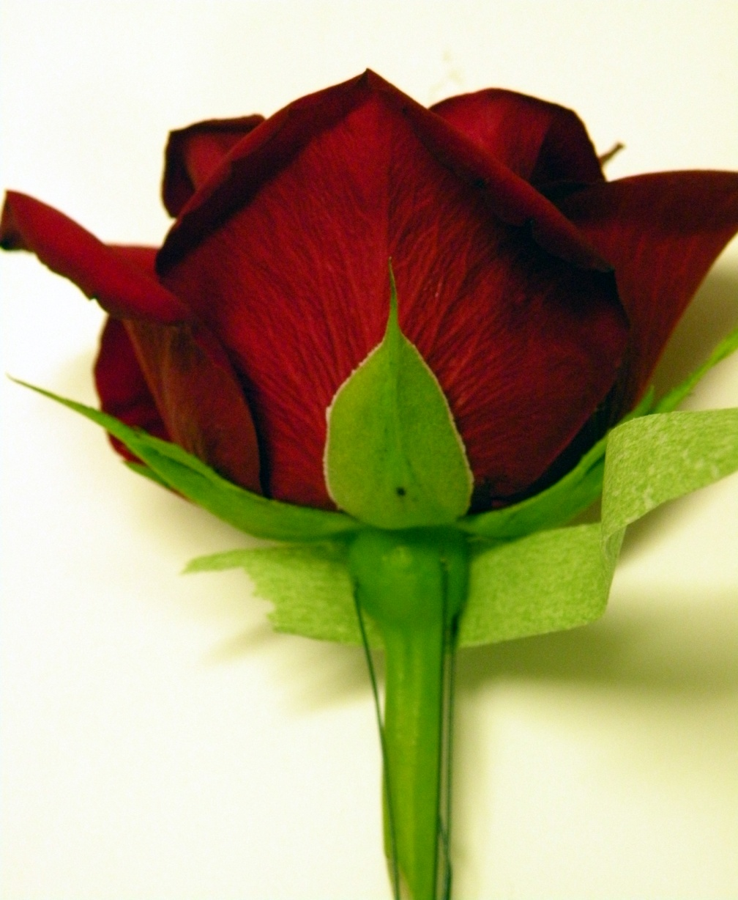
Tape Wired Rose Stem
If sepals are hanging down,
do not remove, simply
move aside
Tape around receptacle with
floral tape, being careful
to cover all insertion holes
and pulled tight to top of
stem
Tape should be pulled tight
and smooth all along stem
No curled (pig tail) stems,
please!
Be sure there are no barbs
or pieces of wire showing
along the stem or at the
bottom of the stem
sepal
sepal

Slide 41
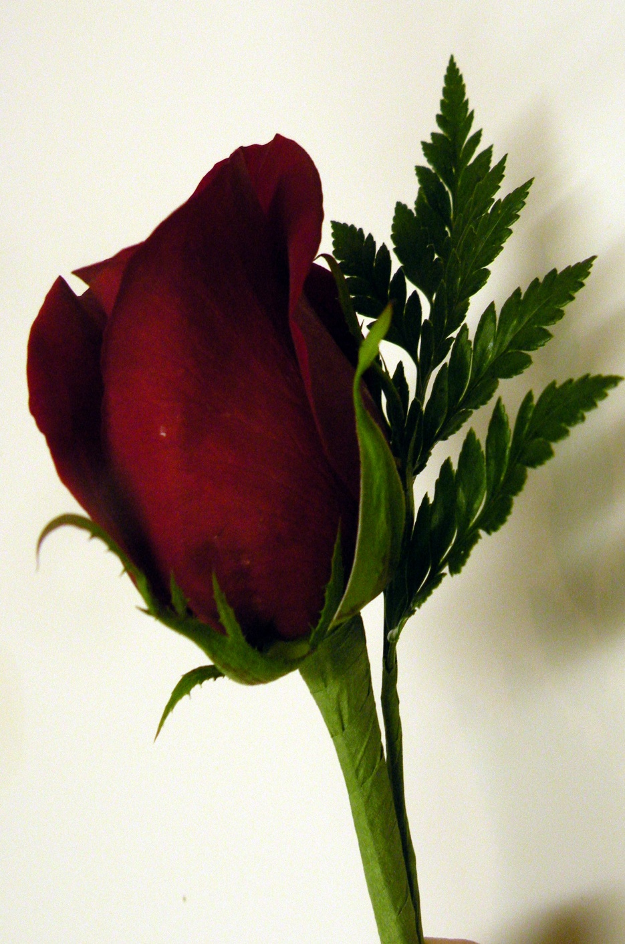
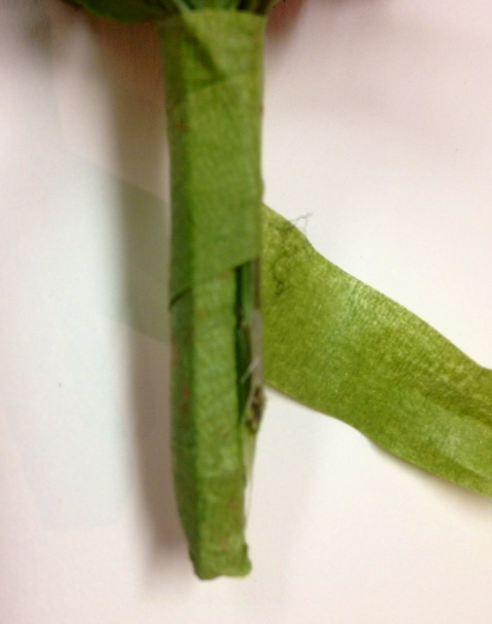
Should you choose to use Leather Leaf Fern
for your boutonniere:
Tape Rose and Foliage Together
Lay Leather Leaf Fern so that
the lower end of the fronds
fit close to the bottom of
the rose head.
The tip of the leather leaf
should be just slightly above
the head of the rose, within a
range of 1-2 inches, maximum,
in proportion and scale to
the size of the rose head.
Shave leather leaf stem half way down the stem length of the rose and then tape stem and foliage together. This prevents the stem
from becoming so thick with tape!
Shave leather leaf
stem at an angle to prevent bulk!

Slide 42
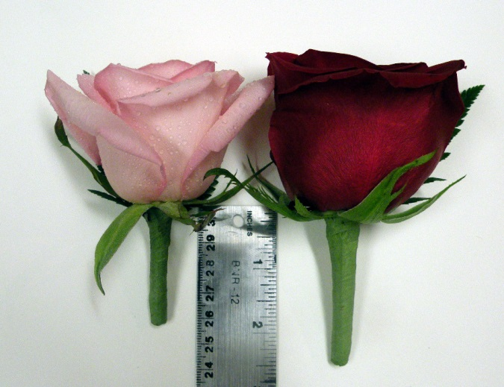
The Stem Length for A Rose
Boutonniere
Head Length:
1½” to 2”
Head
Length
2” to 2 ½”
“
Reminder:
The length of the stem of your boutonniere is
proportionate to the head size of the rose.
The smaller the head size of the rose, the shorter the stem.
The larger the head size of the rose, the longer the stem.
Remember: stem length is
proportionate to head size!

Slide 43
Completed Rose
Boutonniere

Slide 44
Copyright 2011
Texas State Florists' Association
PO Box 170760
Austin, Texas 78717
United States of America
All rights reserved, including the rights of reproduction and use in any form or by any means, including the making of copies by any photo process, or by any mechanical or electronic device, printed, written or oral, or recording for sound or visual reproduction or for use in any knowledge or retrieval system or device.
www.tsfa.org
512-834-0362
800-375-0361
txsfa@sbcglobal.net

